Slide 1
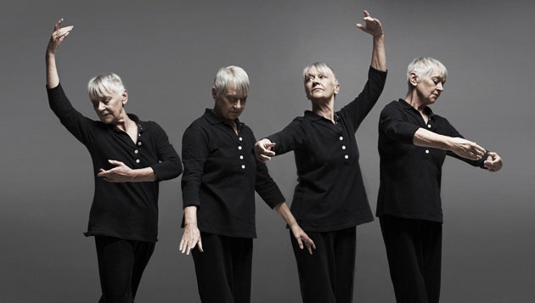
EXPLORING PRAYER WITH OLDER PEOPLE
Notes:
Why I think this subject is important, both for ourselves, our church and our society
How we think prayer changes as we grow older
Interactive
Reflections from others
Ideas and resources for praying for and with those who are older
The picture is chosen to pose the question – ‘How much does prayer depend on words?’

Slide 2
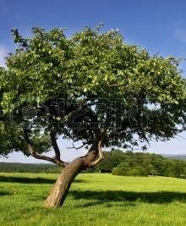
They still bear fruit in old age; they are ever full of sap and green
Psalm 92: 14
Notes:
The righteous flourish like the palm tree, and grow like a cedar in Lebanon.
They are planted in the house of the Lord; they flourish in the courts of our God.
God has a plan and purpose for each of us, and we are inherently precious to Him, whoever we are and whatever season of life we are in; from a new born baby, to a disabled young adult, to a frail and vulnerable older person,
Moses, Abraham and Sarah, Joshua, Zechariah and Elizabeth

Slide 3
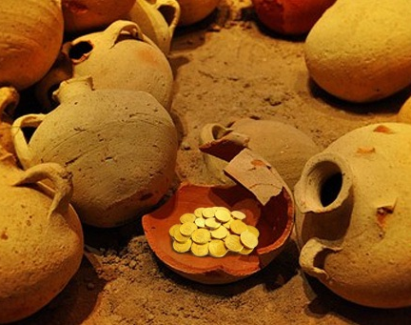
Therefore we do not lose heart. Though outwardly we are wasting away, yet inwardly we are being renewed day by day
2 Corinthians 4: 16
Notes:
As we think about prayer and our relationship with God in our later years, I return again and again to Paul’s letter to the Church in Corinth.
Paul reflects profoundly on the reality of our physical diminishment as we grow older and frailer – reminding us of the treasure within bodies that become like fragile clay jars
As we grow older, we need to reflect on, not only building up that treasure within, but understanding that we can continue to grow spiritually

Slide 4
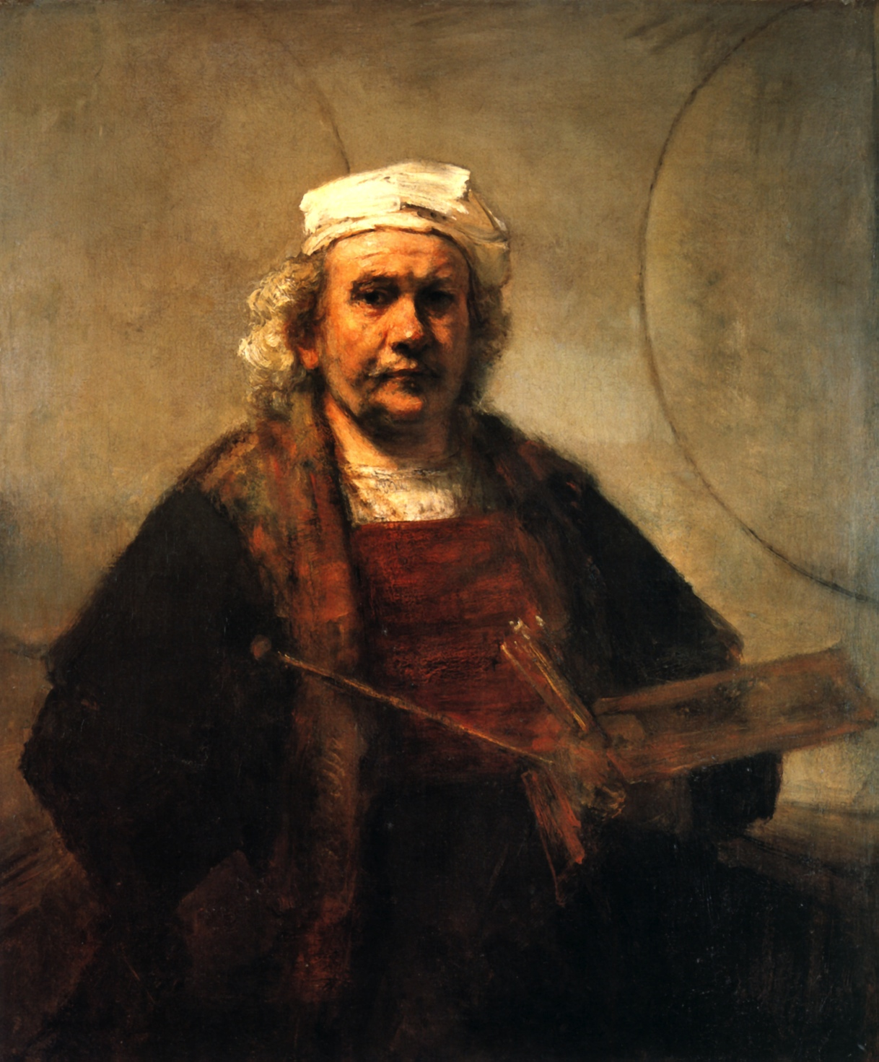
Rembrandt van Rijn 1669
“a pattern of decay confronts my stare, but I shall paint God’s image breaking through”
David Corfe
‘The Road Taken – 1990-2013’
Notes:
Aged 63 years

Slide 5
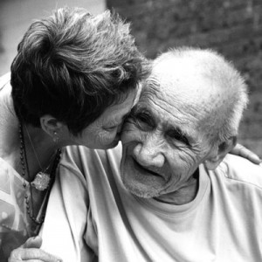
Discovering Our Value and Our Identity
We do not discover who we
are , we do not reach true
humanness, in a solitary state;
We discover it through mutual
dependency, in weakness, in
learning through belonging.
Jean Vanier (1999)
Notes:
As we think about a theology of ageing and our prayer life, I think JV’s work is really helpful; not specifically written of course about those who are older but drawn from his experience of working and living alongside those who are cognitively disabled.
Vanier suggests that it is through belonging that our personhood is fully realized. And so for those who are older and more vulnerable, for those who have lost their independence, this theology of mutual dependency establishes a culture that challenges the individualism that we encounter in our society, providing us with a helpful framework which highlights not only the possibility of a fruitful and resourceful life even at our most frail, but also our role in praying with and alongside those in their later years

Slide 6
“one cannot live the afternoon of life according to the program of life's morning: for what was great in the morning will be of little importance in the evening, and what in the morning was true will at evening have become a lie”
Carl Jung
Notes:
As we grow older our priorities change, the way we view the world around us shifts imperceptibly, the psychological tasks of ageing – reviewing and reflecting on one’s life, facing the reality of age and death and finding meaning and rediscovering hope in new ways all inform our prayer life and our relationship with God in these later years

Slide 7
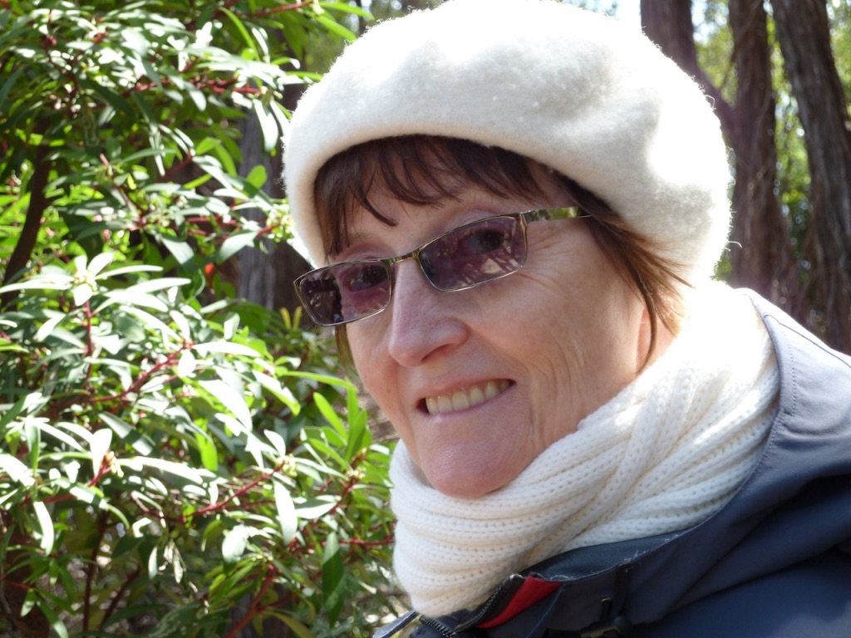
“I need you to minister to me, to sing with me, pray with me, to be my memory for me”
Christine Bryden
Notes:
As I lose an identity in the world around me, which is so anxious to define me by what I do and say, rather than who I am, I can seek an identity by simply being me, a person created in the image of God.
As I travel towards a dissolution of my self, my personality, my very ‘essence’, my relationship with God needs increasing support from you, my other in the body of Christ, don’t abandon me at any stage, for the Holy Spirit connects us, it links our souls, our spirits – not our minds or brains. I need you to minister to me, to sing with me, pray with me, to be my memory for me

Slide 8
Prayer In our Older Years
Notes:
Ageing is a process of truth, reconciliation and restoration
Rembrandt 1631
How has your prayer life changed over the years?
What informs the way you pray now that is different to the past?

Slide 9
“The Prayer of the Elderly is a Beautiful Thing”
Notes:
Dear grandparents, dear elderly, let us follow in the footsteps of these extraordinary elders! Let us too become like poets of prayer: let us develop a taste for finding our own words, let us once again grasp those which teach us the Word of God. The prayer of grandparents and of the elderly is a great gift for the Church! It is a treasure! We need old people who pray because this is the very purpose of old age. The prayer of the elderly is a beautiful thing.

Slide 10
Exploring Prayer with Others
Prayer transforms us; it’s not about us changing God
It’s about silence not words; it’s being in His presence
Prayer is part of life
There is more time to pray, to talk to God
Learning to take my prayer life more slowly
Old prayers go deep; love childhood prayers
No lists anymore; wait to be prompted by Holy Spirit
Notes:
I seem to have acquired a huge list of people and causes to pray for (Open Doors, Tear Fund Interserve etc.all with daily prayer requests), so much so that they are becoming a bit of a burden. So I have begun consciously thinking of Jesus the High Priest ever interceding for us, and trying to hitch my prayer to his; I don't have to tell him all the details, but let him take the strain, relying on the Spirit's guidance. I just mention briefly the person or issue, and move on, unless there seems a special reason for spending longer. I'm not sure how useful this kind of praying can be, but then it is amazing how God uses our prayer at all!

Slide 11
Exploring Prayer with Others
Learning not to be
“curved in upon oneself”

Slide 12
"If I were asked for the most important advice I could give, that which I considered to be the most useful to the men of our century, I would simply say: in the name of God, stop a moment, cease your work, look around you.”
Leo Tolstoy 1908
Notes:
1908 – only known colour photograph of Leo Tolstoy

Slide 13
PRAYING IN OUR OLDER YEARS
God’s Story
God’s Character
God’s Promises

Slide 14
I wonder

Slide 15
The Master Weaver

Slide 16
“And to know the love of Christ, which passeth knowledge, that ye might be filled with all the fullness of God.”
Ephesians 3 : 19 (KJV)

Slide 17
God’s Promises
Notes:
Bible reading notes – Gift of Years
Promise Bag
Prayers from CW, Lord’s Prayer, Psalm 23

Slide 18
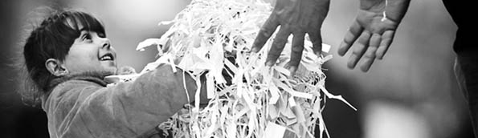
Aged men and women once again will sit in the squares of Jerusalem, each with a stick to lean on because of their great age.
And the squares will be full of boys and girls playing there
Zechariah 8: 4-5
Notes:
God’s Vision
Celebrate the seasons of our life together; where it is natural for the generations to gather, to co-exist in mutual respect, love and care for the other.
Prophecy celebrating all that is good in older years as well as the joy of being young!

Slide 20
The Philosophy of
Kintsugi
Japanese fill damaged pots with gold
The old and damaged has history and becomes more beautiful

Slide 21
Transcend Loss/Disability
Find Final Meaning
Meaning in Life
Find intimacy with God
and /or others
Find Hope
Elizabeth MacKinlay : Model of Spiritual Tasks of Ageing
Notes:
Seven Tasks of Ageing Jung
To face the reality of age and death
Review and reflect and sum up one’s life
Draw some mental boundaries: preserve and select time and energy.
Overcome ego
Rediscover God in self
Find meaning through memory and analysis
Be creative and playful

