Slide 1
Global Partners
In Prayer

Slide 2
PAST
⁸ But you will receive power when the Holy Spirit comes on you; and you will be my witnesses in Jerusalem, and in all Judea and Samaria, and to the ends of the earth.’
Acts 1:8

Slide 3
PAST
⁸ But you will receive power when the Holy Spirit comes on you; and you will be my witnesses in Jerusalem, and in all Judea and Samaria, and to the ends of the earth.’
Acts 1:8
FUTURE
⁹ After this I looked, and there before me was a great multitude that no one could count, from every nation, tribe, people and language, standing before the throne and before the Lamb. They were wearing white robes and were holding palm branches in their hands. ¹⁰ And they cried out in a loud voice:
‘Salvation belongs to our God, who sits on the throne, and to the Lamb.’
Revelation 7:9-10

Slide 4
PAST
⁸ But you will receive power when the Holy Spirit comes on you; and you will be my witnesses in Jerusalem, and in all Judea and Samaria, and to the ends of the earth.’
Acts 1:8
PRESENT
FUTURE
⁹ After this I looked, and there before me was a great multitude that no one could count, from every nation, tribe, people and language, standing before the throne and before the Lamb. They were wearing white robes and were holding palm branches in their hands. ¹⁰ And they cried out in a loud voice:
‘Salvation belongs to our God, who sits on the throne, and to the Lamb.’
Revelation 7:9-10

Slide 5
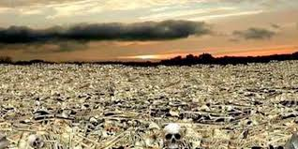
By Word and
Spirit –
from this
to this

Slide 6
“Christ has no body now but yours.
No hands, no feet on earth but yours.
Yours are the eyes through which he looks compassion on this world.
Yours are the feet with which he walks to do good.
Yours are the hands through which he blesses all the world.
Yours are the hands, yours are the feet, yours are the eyes, you are his body.
Christ has no body now on earth but yours.”
Teresa of Avila

Slide 7
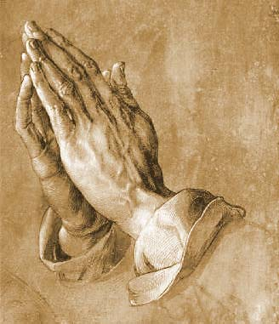
Shared Prayer
Phil 1:4 Paul prays for the Philippians
Phil 1:19 The Philippians pray for Paul

Slide 8
Use Your Existing Connections
Any links or partnerships your local church or denomination has
Any mission partners, aid workers or business people in your congregation you are in touch with
Any civic twinning associations
Any denominational or international agencies you work with – CAFOD, CMS, USPG, Tearfund, Christian Aid, Mothers’ Union

Slide 9
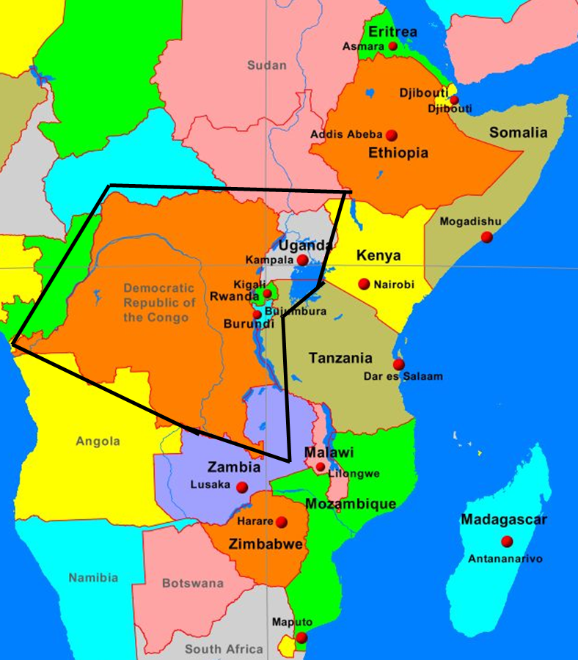
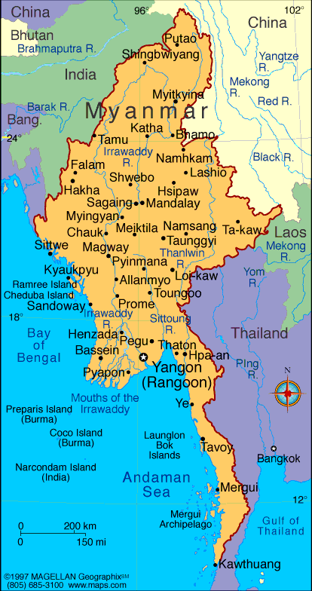
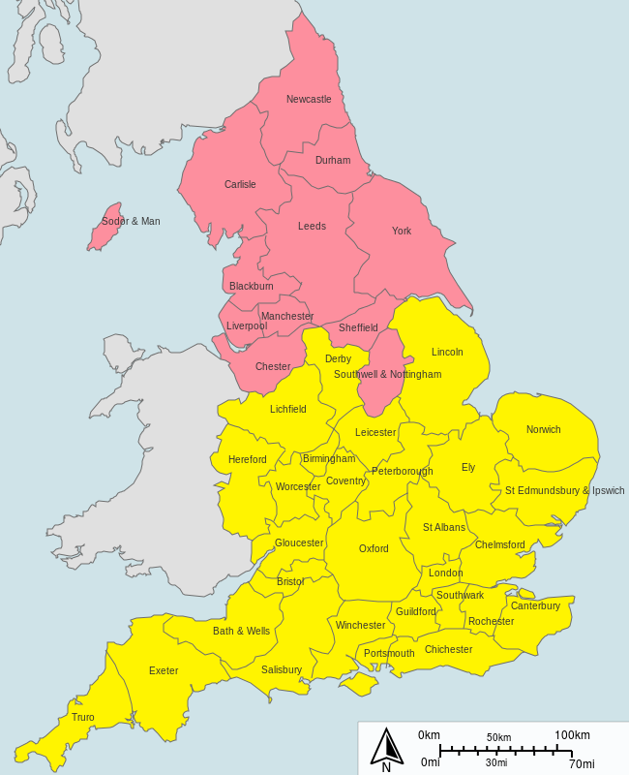
Myanmar
Newcastle
Burundi
DR Congo
Rwanda
Uganda

Slide 10
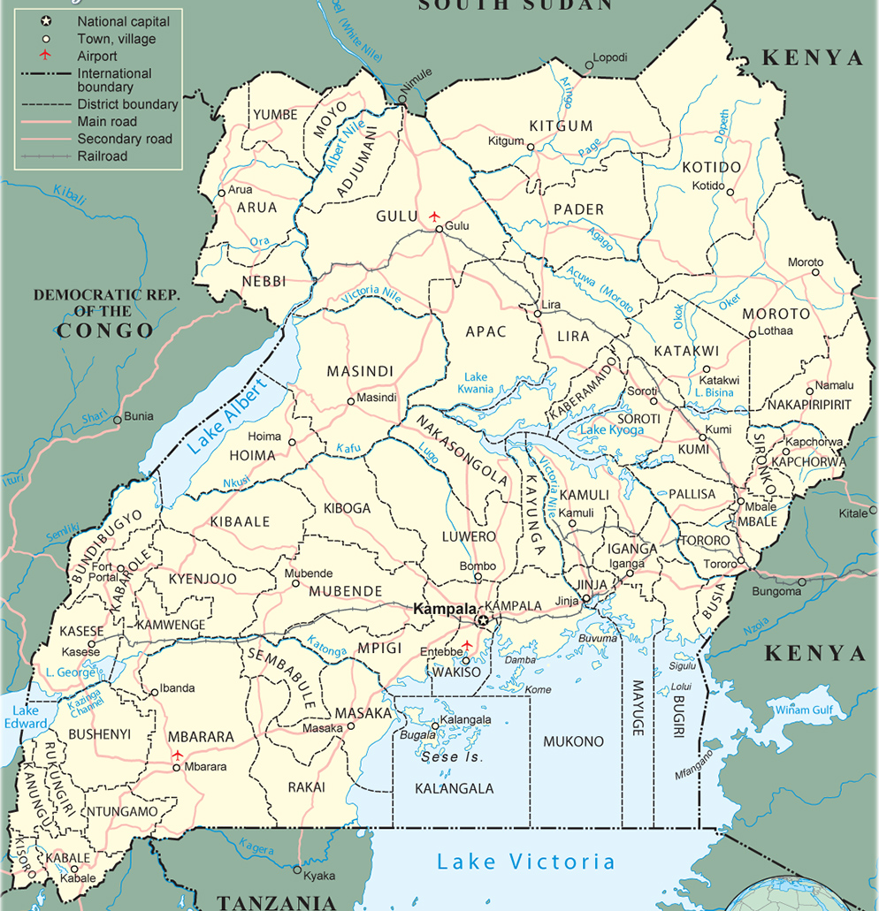
Alresford
Lango
Alton
Karamoja;
Northern Karamoja
Odiham
Bunyoro Kitara
Whitchurch
Mityana
Bournemouth
Soroti; Kumi
Romsey
S Rwenzori
Eastleigh
Bukedi
Christchurch
Kinkiizi
Southampton
Busoga
Lyndhurst
Rwanda
Winchester
Muhabura
Diocese of Winchester Deanery Links

Slide 11
Some Suggestions
Link up during the Novena with a Skype call, or agree to pray separately but at the same time
Use the prayer feeds from websites in daily prayers
Access any on-line local papers for news stories
Exchange prayer items with your links so praying for one another

Slide 12
From every nation, tribe, people and language

